Slide 1
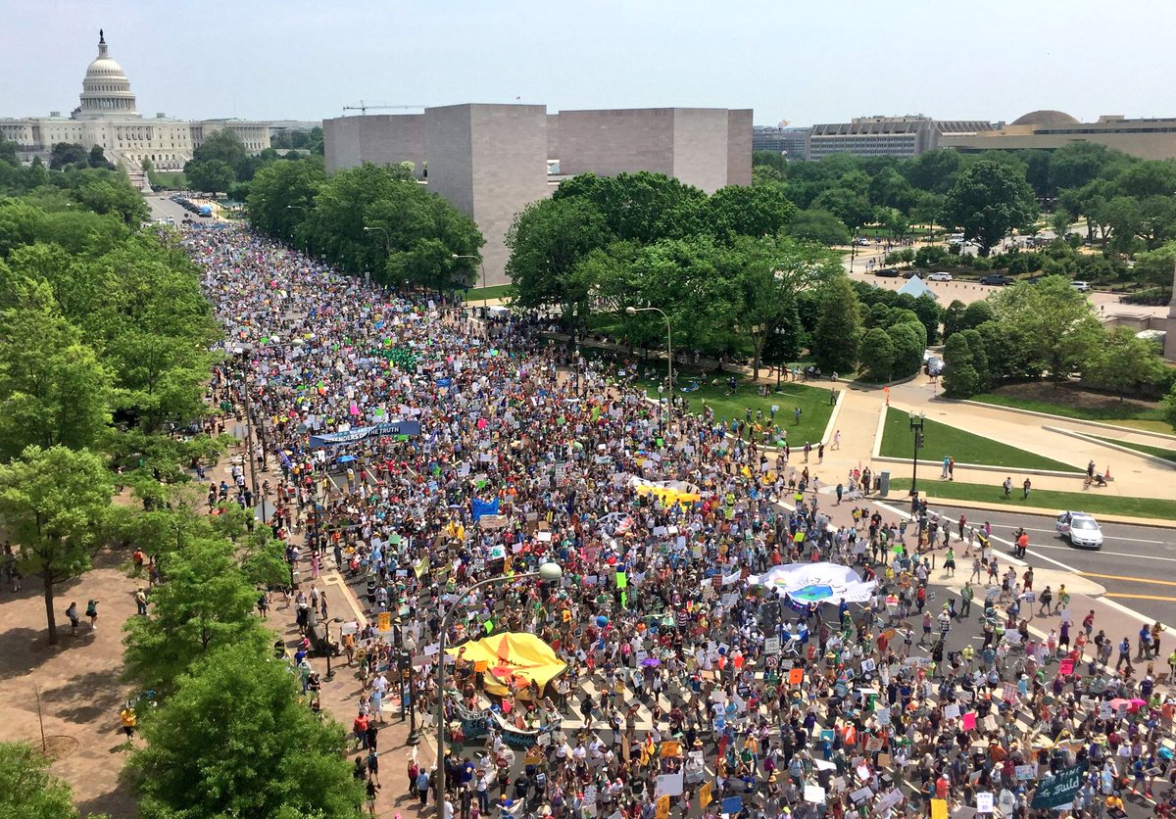
Advocacy

Slide 2
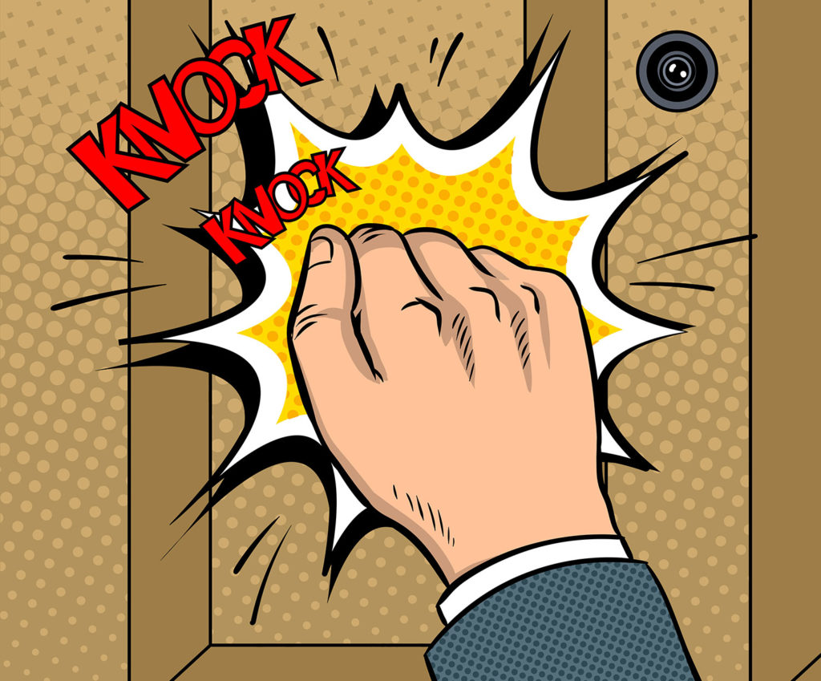
Take aways:
“Show Up”
Rely on legit partner organizations
Do what you can w/o getting overwhelmed or depressed

Slide 3
Liberating Advocacy
For God’s sake, standing alongside marginalized, vulnerable peoples, we will advocate and act to repair Creation and seek the liberation and flourishing of all people.

Slide 4
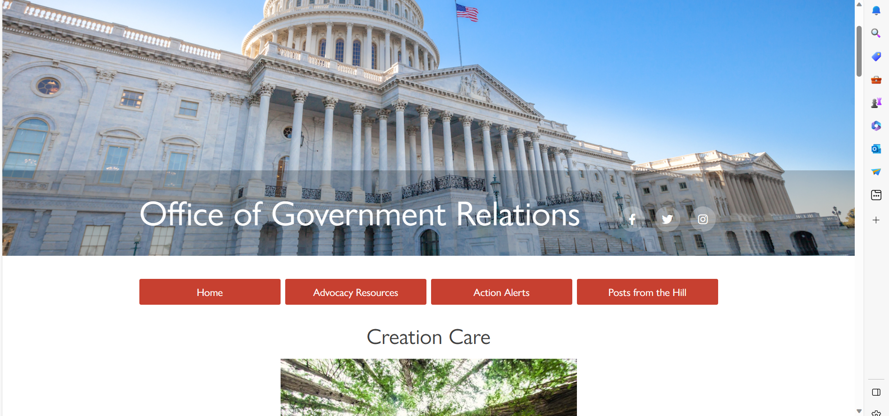

Slide 5
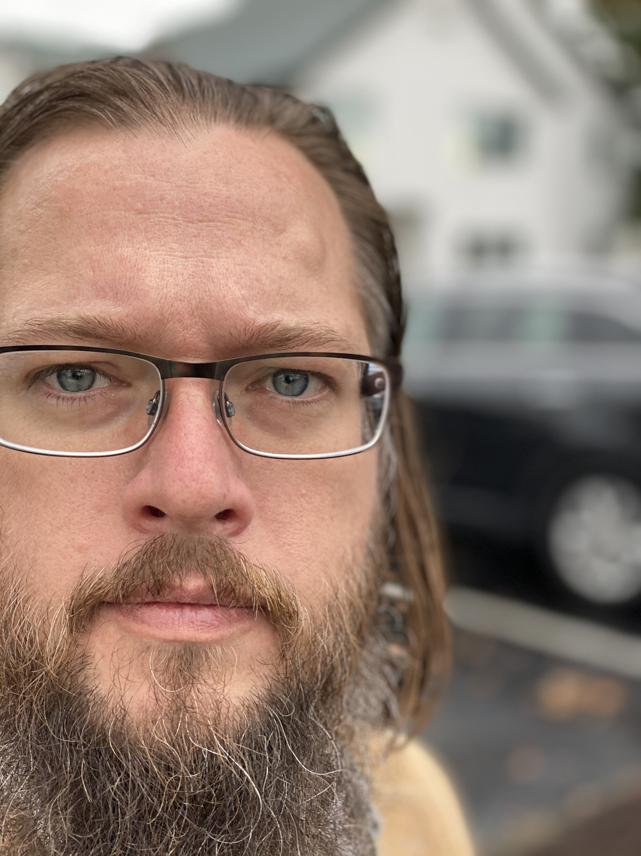
An Episcopal Path to Creation Justice
“We have developed a four-fold focus on:
Praying
Learning
Acting
Advocating
as we call our parishes toward Creation Justice”
John Lein
Episcopal Church parish priest, artist, and writer
Co-Author of the Episcopal Season of Creation Liturgy

Slide 10
The Areas of the Advocacy Pillar:
Communication
Connection
Citizenship
Direct Action
Private Sector Advocacy
Public Sector Advocacy

Slide 11
Connection
Some Great Groups:
Citizens Climate Lobby: Federal Level
Michigan League of Conservation Voters: State
Sierra Club: All levels
MICAN: State
Michigan Interfaith Power and Light: State
Climate Witness Project
Grand Rapids Climate Coalition: City/County
WMEAC: West Michigan
SunRise: Youth

Slide 12
Action Alerts
Weekly Network Call Thursdays 1:00- 1:30

Slide 13
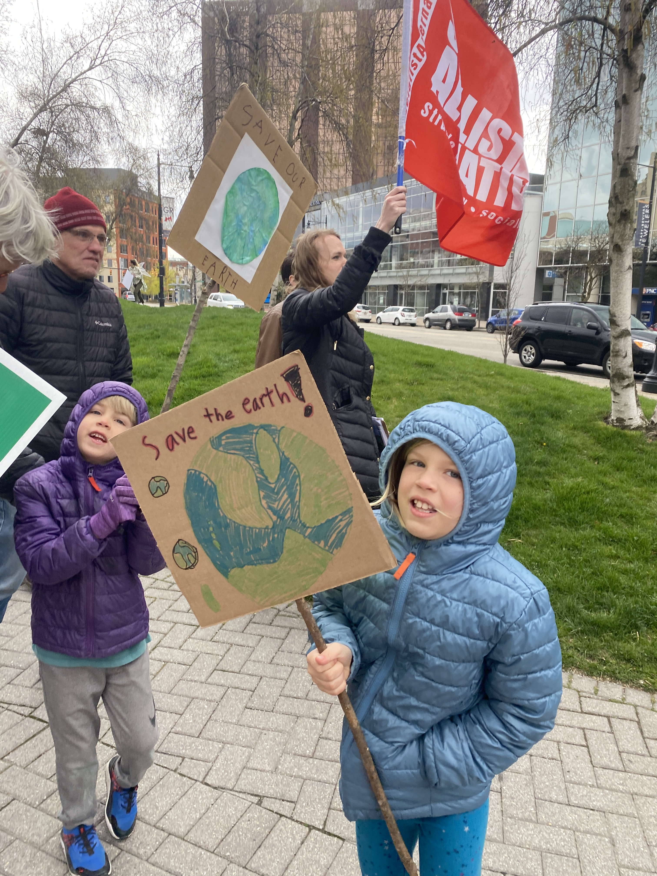
Direct Action
Stay alert to opportunities
Just “Show Up” and have FUN

Slide 14
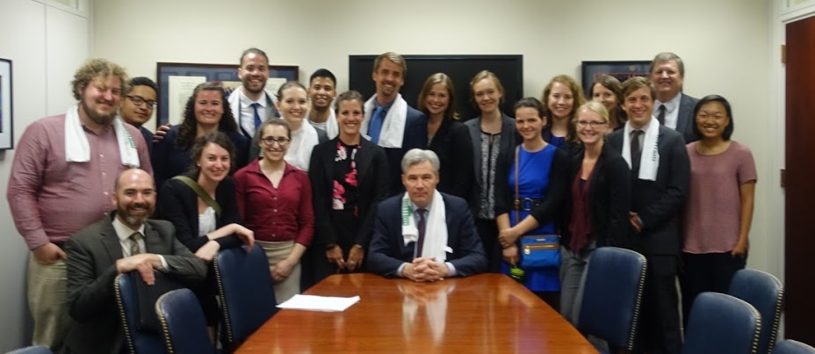
Public Sector Advocacy
“Show Up” and keep showing up (build relationships)
Sign up for Episcopal Policy Network Action Alerts (EPPN)

Slide 15
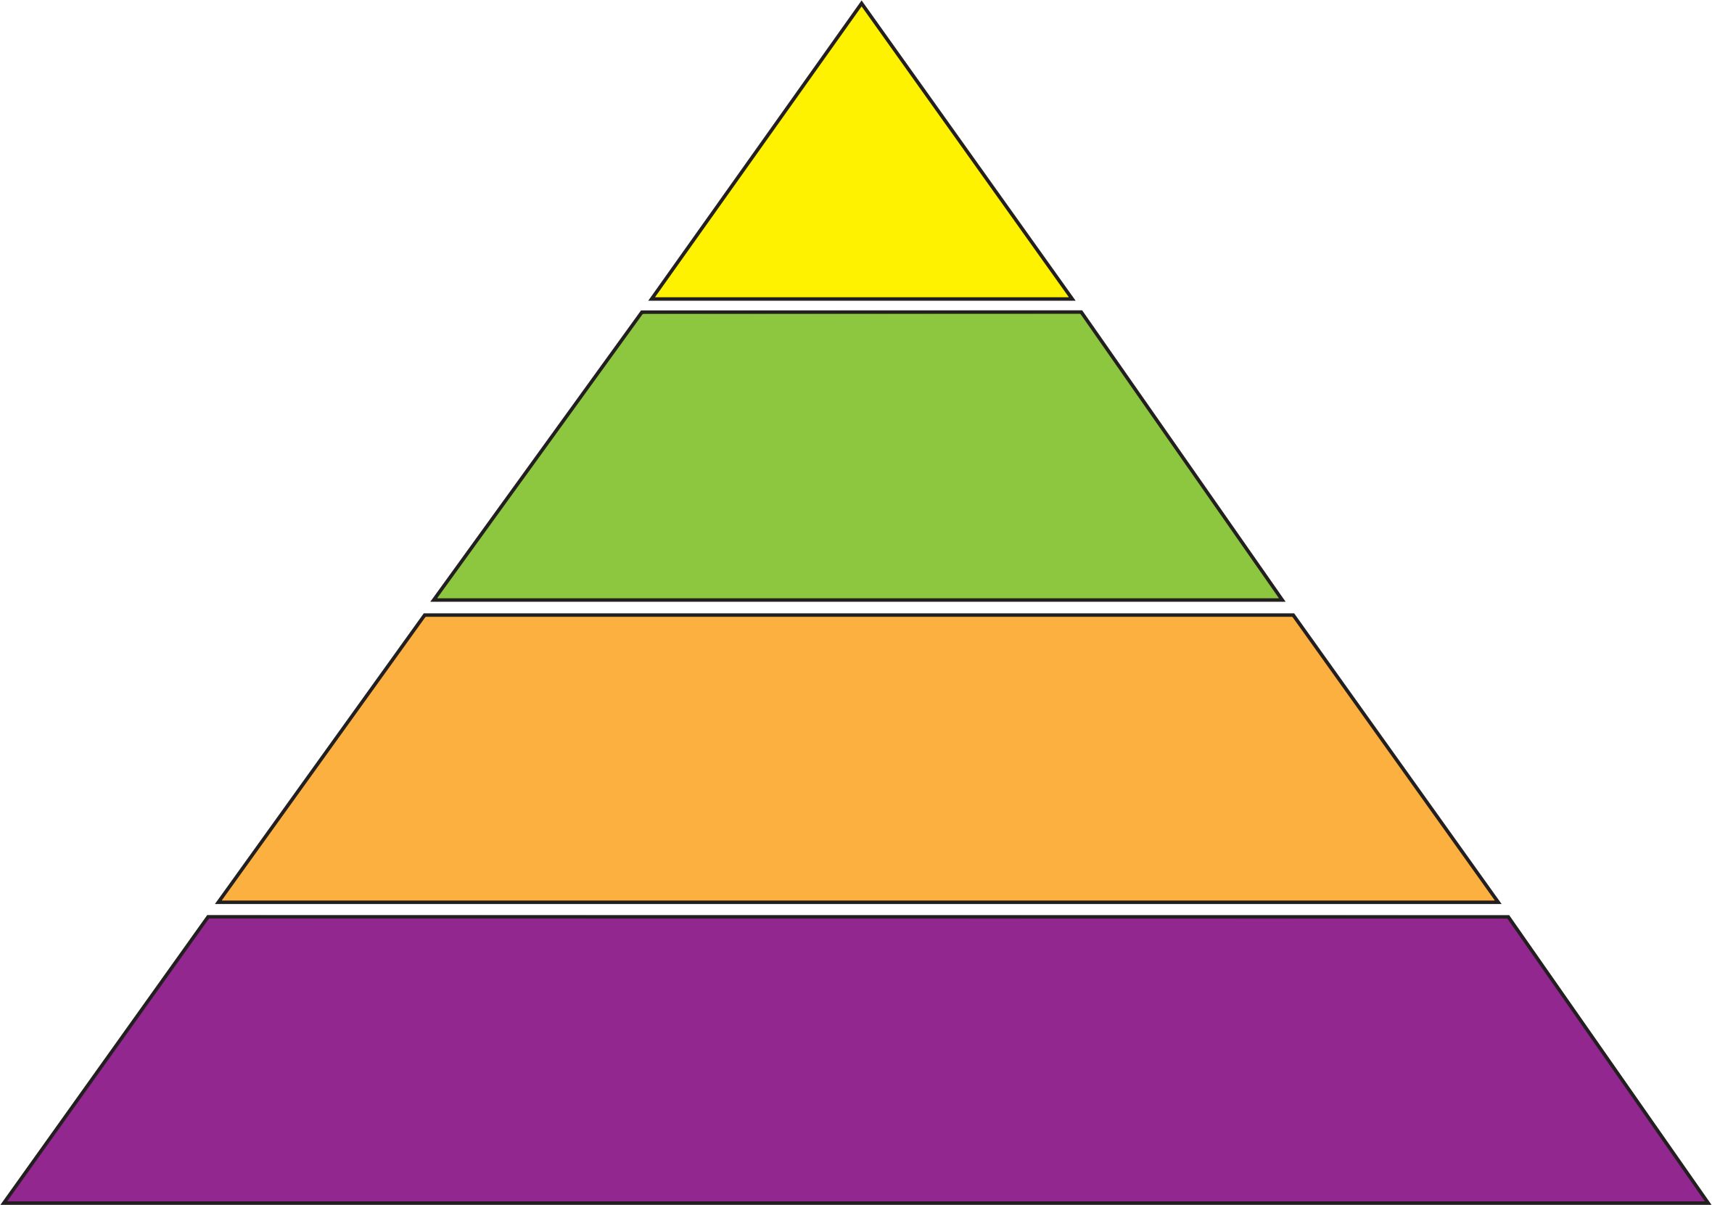
Influence Pyramid
Visit
Write
Phone
eMail

Slide 16
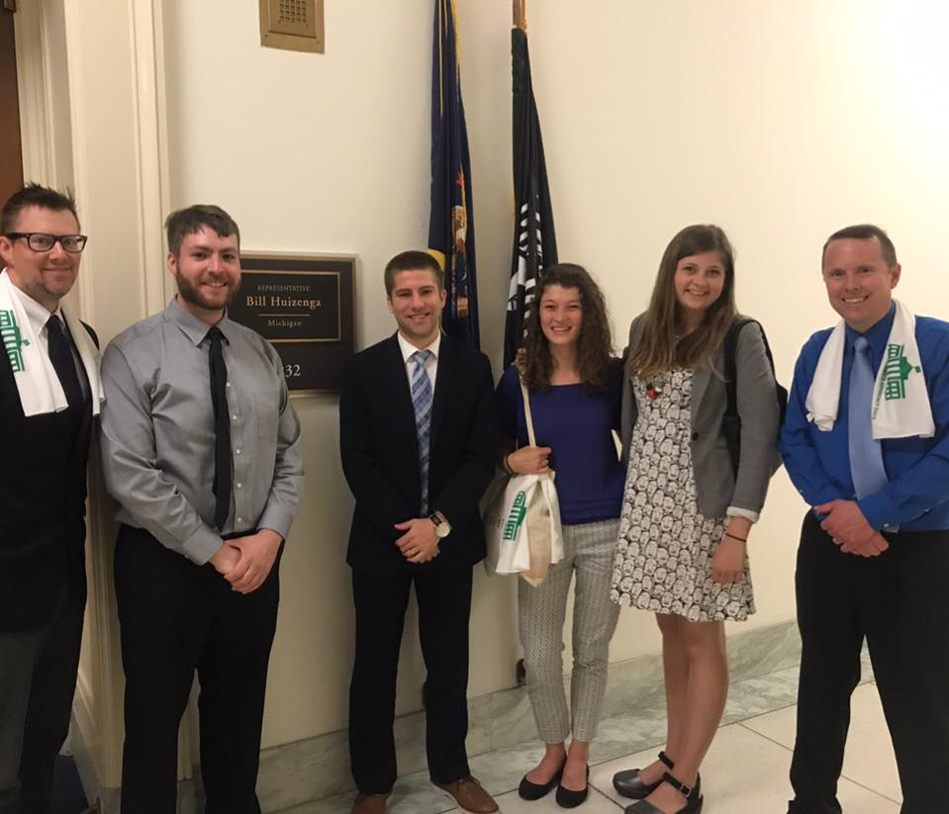
What’s the Message?
Thank you for _________!
I (we) as people of Faith, and your constituent, expect you to take action on the Climate Crisis
Please explain what actions you are currently taking.
Today (I) we are asking you to take this specific action…
How can I (we) help you take action on this and the larger Climate Crisis?
Thank you for your time.

Slide 17
Anneke’s Advocacy Journey

Slide 18
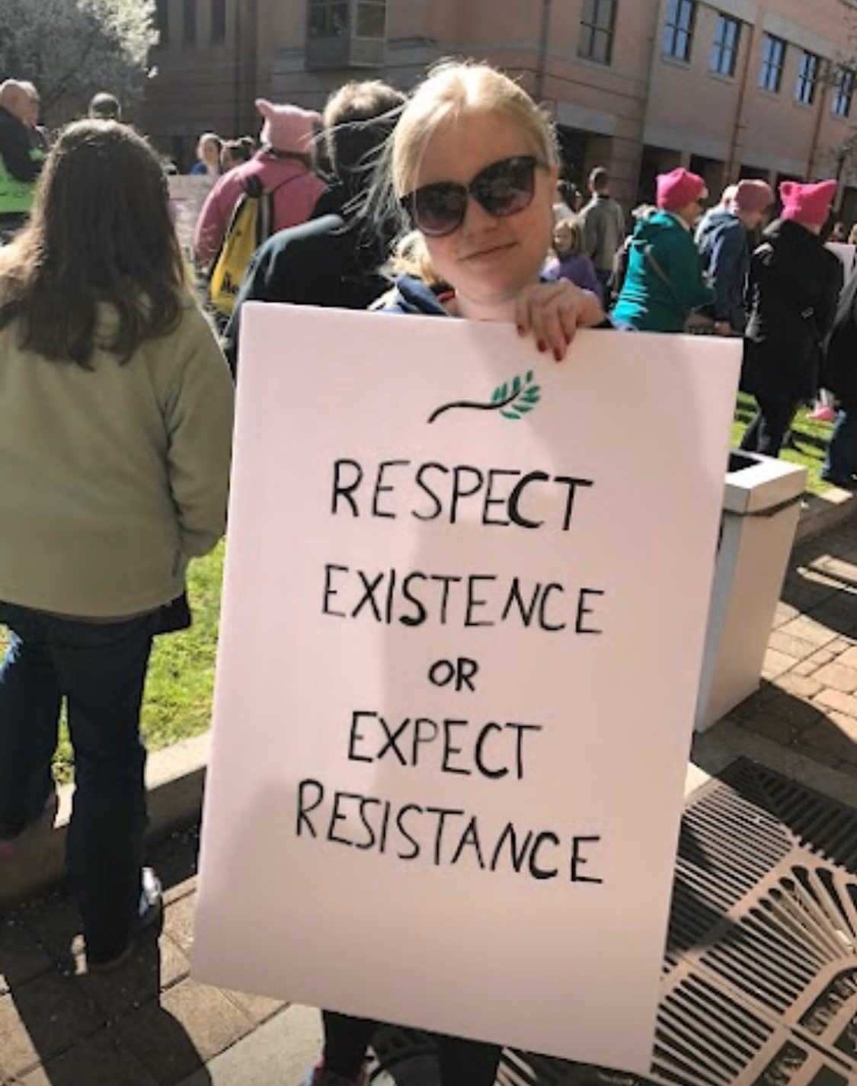

Slide 21
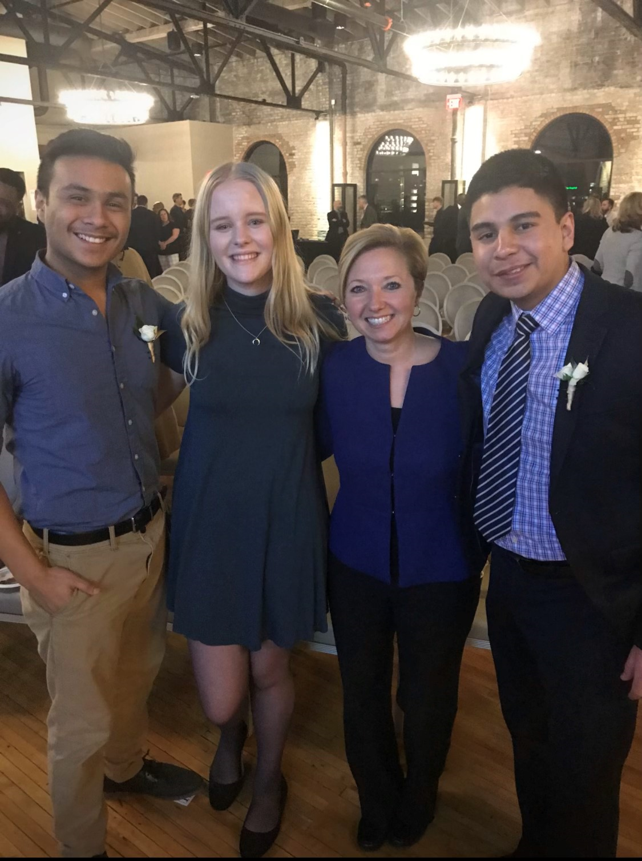

Slide 22
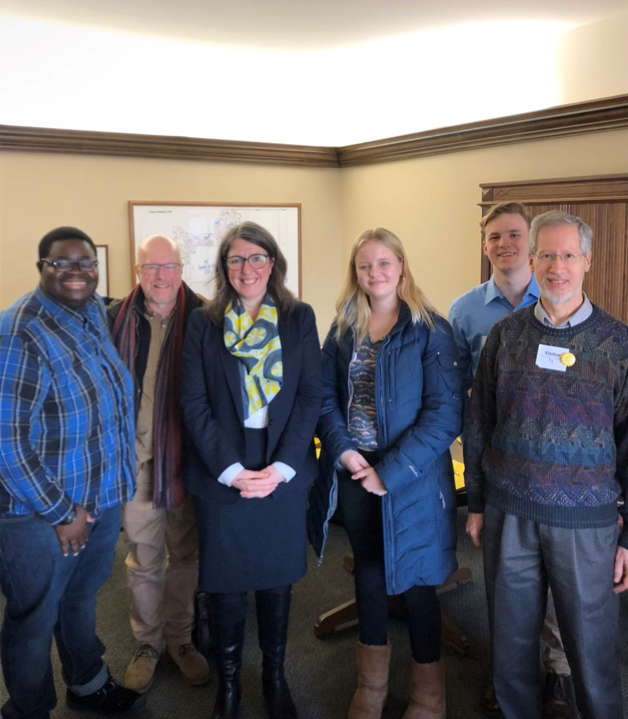

Slide 23
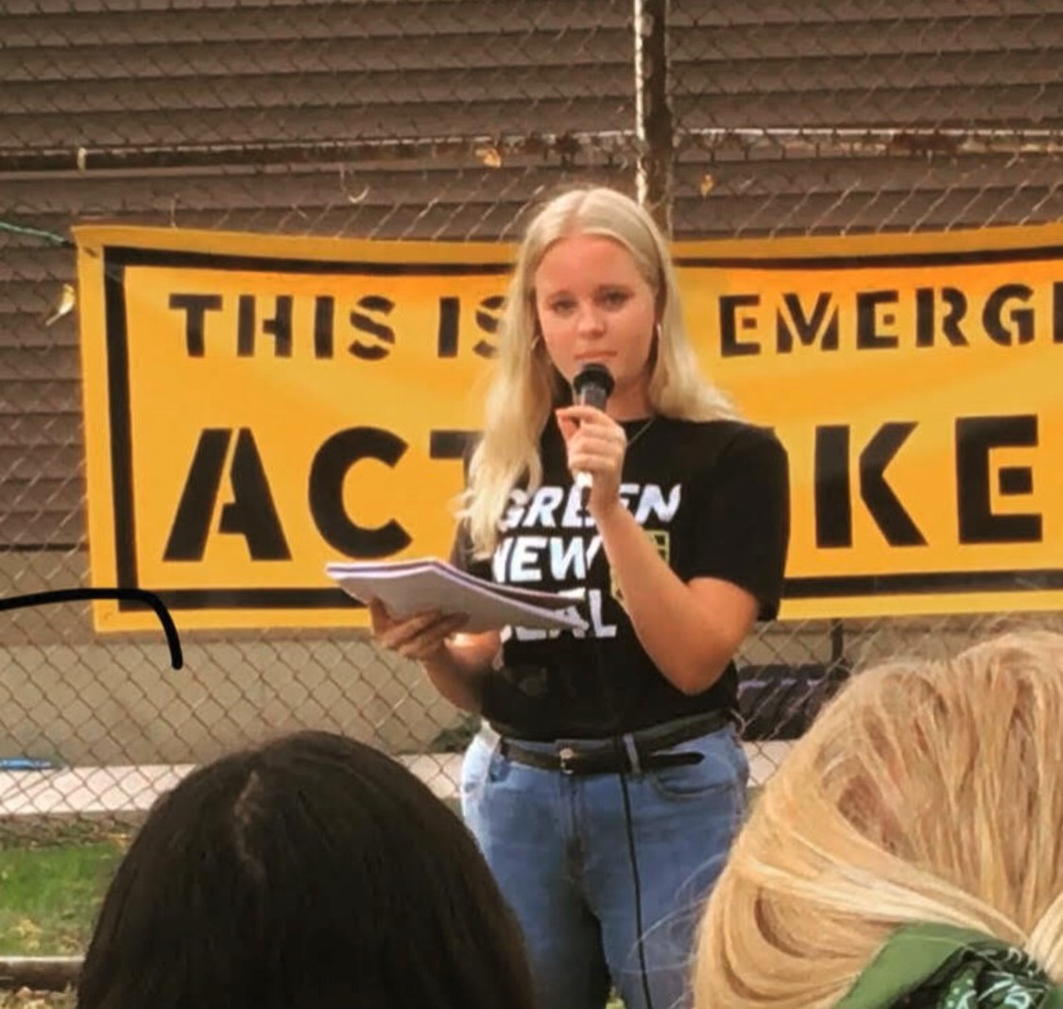

Slide 24
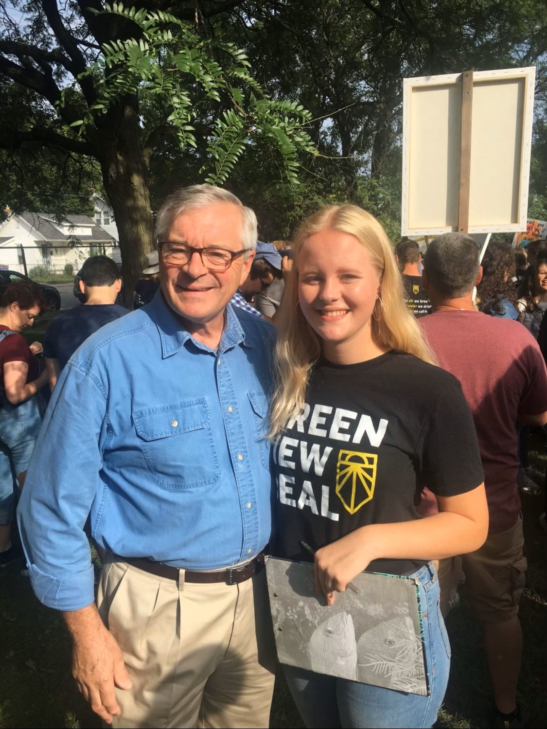

Slide 25
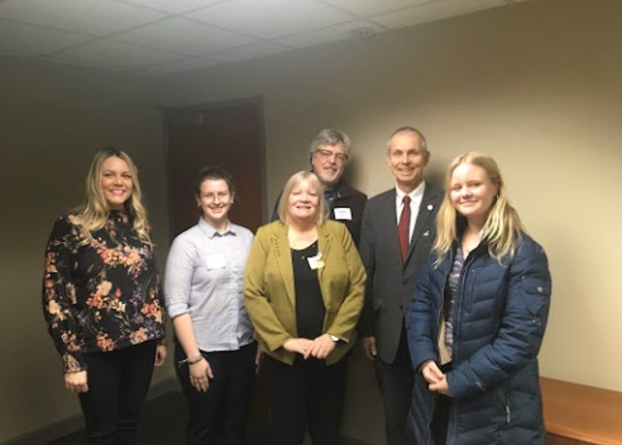

Slide 26
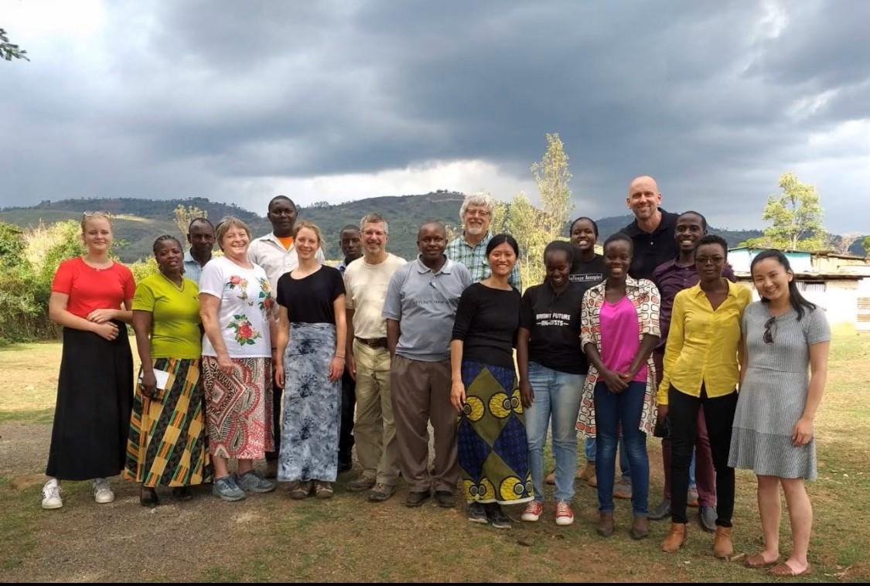

Slide 27
Google: Michigan Energy Michigan Jobs

Slide 29
Take aways:
“Show Up”
Rely on legit partner organizations
Do what you can w/o getting overwhelmed or depressed

